Slide 1
Propensity Score Matching
TO FIND MATCHING KIDS FROM INTERVENTION TO THOSE IN NON-INTERVENTION

Slide 2
Introduction
Propensity Score Matching is a statistical technique in which a treatment score is matched with one or more control cases based on each case’s propensity score.
We have used the MatchIt package from R and nearest neighbors algorithm to perform the matches.

Slide 3
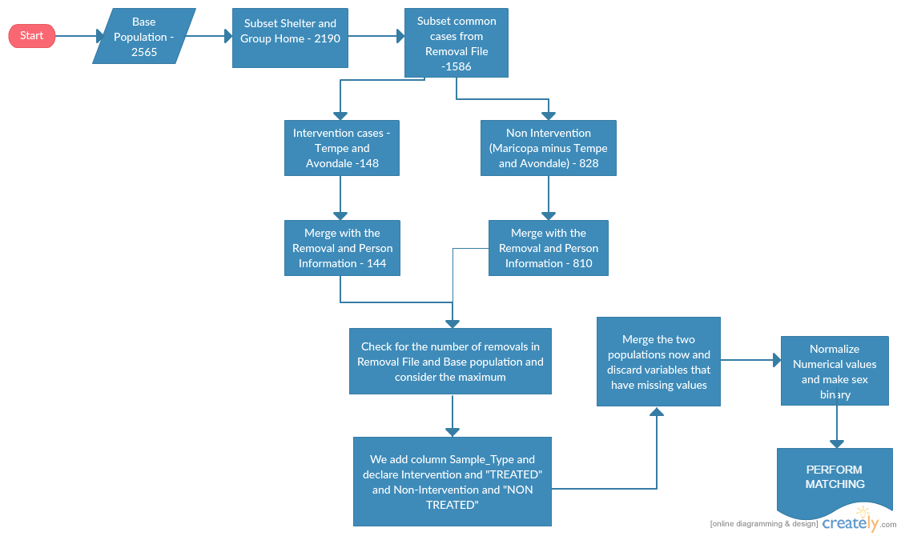
Overview:

Slide 4
Jitter plots:

